Slide 1

Module 7
functions of several variables
partial derivatives
maxima and minima
lagrange multipliers
tangent planes and differentials

Slide 2
Module 7
functions of several variables

Slide 3
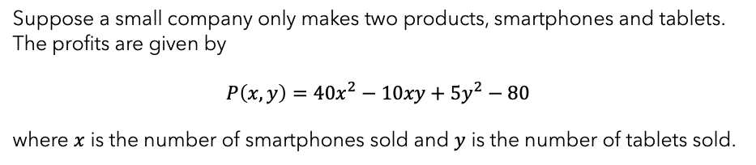
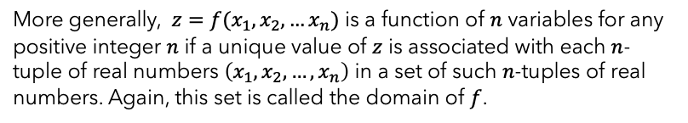
functions of two variables
$z=f(x,y)$ is a function of two variables if a unique value of $z$ is associated with each ordered pair of real numbers $(x,y)$ in some set of ordered pairs of real numbers. This set is called the domain of $f$.
More generally, $z=f(x_{1},x_{2},…x_{n})$ is a function of $n$ variables for any positive integer $n$ if a unique value of $z$ is associated with each $n$-tuple of real numbers $\left(x_{1},x_{2},…,x_{n}\right)$ in a set of such $n$-tuples of real numbers. Again, this set is called the domain of $f$.
Suppose a small company only makes two products, smartphones and tablets. The profits are given by
$$P\left(x,y\right)=40x^{2}−10xy+5y^{2}−80$$
where $x$ is the number of smartphones sold and $y$ is the number of tablets sold.
Notes:
Slide 3: What is the domain of a given function of two variables (#2).

Slide 4
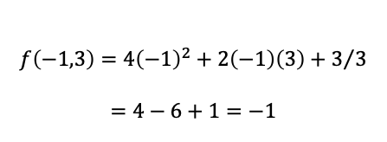

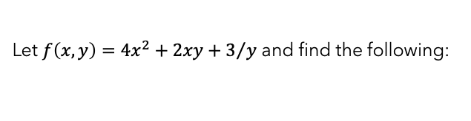



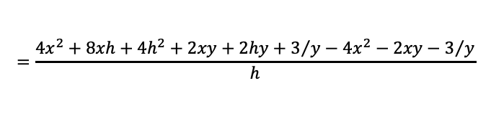

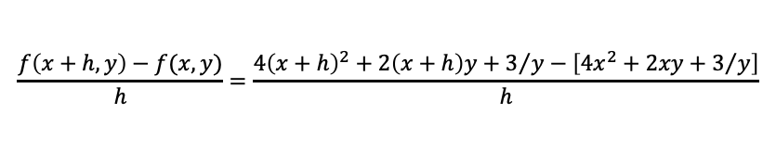

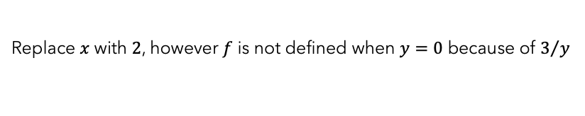
evaluating functions
Let $f\left(x,y\right)=4x^{2}+2xy+3/y$ and find the following:
$$f(−1,3)$$
$$\frac{f\left(x+h,y\right)−f(x,y)}{h}$$
Replace $x$ with $−1$ and $y$ with $3$
$$\frac{f\left(x+h,y\right)−f(x,y)}{h}=\frac{4{\left(x+h\right)}^{2}+2\left(x+h\right)y+3/y−\left[4x^{2}+2xy+3/y\right]}{h}$$
$$f\left(−1,3\right)=4{\left(−1\right)}^{2}+2\left(−1\right)\left(3\right)+3/3$$
$$=4−6+1=−1$$
$$=\frac{4x^{2}+8xh+4h^{2}+2xy+2hy+3/y−4x^{2}−2xy−3/y}{h}$$
$$f(2,0)$$
$$=\frac{8xh+4h^{2}+2hy}{h}$$
Replace $x$ with $2$, however $f$ is not defined when $y=0$ because of $3/y$
$$=8x+4h+2y$$
Notes:
Slide 4: Evaluate a function of 2 variables at a point in its domain (#1)

Slide 5





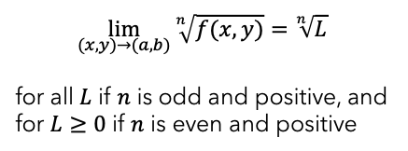
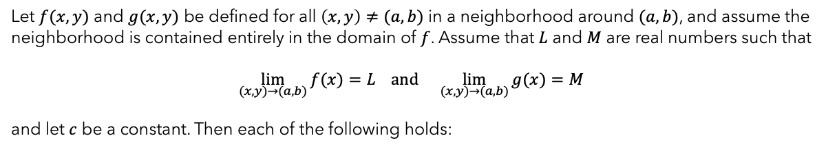
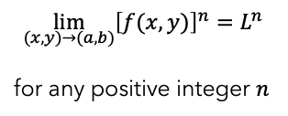
limit laws
Let $f(x,y)$ and $g(x,y)$ be defined for all $\left(x,y\right)≠(a,b)$ in a neighborhood around $(a,b)$, and assume the neighborhood is contained entirely in the domain of $f$. Assume that $L$ and $M$ are real numbers such that
$$\lim_{(x,y)→(a,b)}{f(x)}=L and \lim_{(x,y)→(a,b)}{g(x)}=M$$
and let $c$ be a constant. Then each of the following holds:
$$\lim_{(x,y)→(a,b)}\left[f\left(x,y\right)g(x,y)\right]=LM$$
Product law
$$\lim_{\left(x,y\right)→(a,b)}{c}=c$$
Constant law
$$\lim_{(x,y)→(a,b)}{{\left[f(x,y)\right]}^{n}}=L^{n}$$
for any positive integer $n$
$$\lim_{(x,y)→(a,b)}{x}=a and \lim_{(x,y)→(a,b)}{y}=b$$
Identity laws
Power law
$$\lim_{(x,y)→(a,b)}\left[f\left(x,y\right)±g(x,y)\right]=L±M$$
Sum/difference law
$$\lim_{(x,y)→(a,b)}{\sqrt[n]{f(x,y)}}=\sqrt[n]{L}$$
for all $L$ if $n$ is odd and positive, and for $L≥0$ if $n$ is even and positive
Root law
$$\lim_{(x,y)→(a,b)}{cf(x,y)}=cL$$
Constant multiple law
Notes:
Slides 5-7: Find the limit of a function (#3)

Slide 6

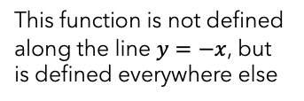
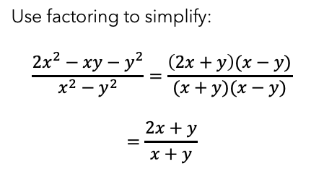




examples
Find the following limits, if they exist
$$\lim_{(x,y)→(5,1)}{\frac{xy}{x+y}}$$
$$\lim_{(x,y)→(1,1)}{\frac{2x^{2}−xy−y^{2}}{x^{2}−y^{2}}}$$
The point $(1,1)$ will cause division by $0$
This function is not defined along the line $y=−x$, but is defined everywhere else
Use factoring to simplify:
$$\frac{2x^{2}−xy−y^{2}}{x^{2}−y^{2}}=\frac{\left(2x+y\right)(x−y)}{(x+y)(x−y)}$$
$$=\frac{2x+y}{x+y}$$
$$\lim_{(x,y)→(5,1)}{\frac{5(1)}{5+1}}=\frac{5}{6}$$
$$\lim_{(x,y)→(1,1)}{\frac{2x^{2}−xy−y^{2}}{x^{2}−y^{2}}}=\lim_{(x,y)→(1,1)}{\frac{2x+y}{x+1}}=\frac{3}{2}$$

Slide 7











techniques
Find the following limits, if they exist:
$$\lim_{(x,y)→(0,0)}{\frac{x−4y}{6y+7x}}$$
$$\lim_{(x,y)→(0,0)}{\frac{x^{2}y^{2}}{x^{4}+3y^{4}}}$$
$(0,0)$ is not in the domain and factoring can’t be done.
$(0,0)$ is not in the domain and factoring can’t be done.
Start by proceeding along the path of the $x$-axis, i.e. $y=0$
Proceed along the path of the $x$-axis, i.e. $y=0$
$$\lim_{(x,y)→(0,0)}{\frac{x−4y}{6y+7x}}=\lim_{(x,0)→(0,0)}{\frac{x}{7x}}$$
$$\lim_{(x,y)→(0,0)}{\frac{x^{2}y^{2}}{x^{4}+3y^{4}}}=\lim_{(x,0)→(0,0)}{\frac{0}{x^{4}}}=0$$
$$=\lim_{(x,0)→(0,0)}{\frac{1}{7}}=\frac{1}{7}$$
Proceed along the path of the $y$-axis, i.e. $x=0$
$$\lim_{(x,y)→(0,0)}{\frac{x^{2}y^{2}}{x^{4}+3y^{4}}}=\lim_{(0,y)→(0,0)}{\frac{0}{3y^{4}}}=0$$
Now proceed along the path of the $y$-axis, i.e. $x=0$
$$\lim_{(x,y)→(0,0)}{\frac{x−4y}{6y+7x}}=\lim_{(0,y)→(0,0)}{\frac{−4y}{6y}}$$
Caution: Two paths with the same limit does not mean the limit exists.
Proceed along a 3rd path, the line $y=x$
$$=\lim_{(0,y)→(0,0)}{−\frac{2}{3}}=−\frac{2}{3}$$
$$\lim_{(x,y)→(0,0)}{\frac{x^{2}y^{2}}{x^{4}+3y^{4}}}=\lim_{(x,y)→(x,x)}{\frac{x^{4}}{4x^{4}}}=\frac{1}{4}$$
Two different paths to $(0,0)$ produce two different limits, i.e. the limit DNE
This limit is different than the first two, so the limit DNE

Slide 8
Module 7
partial derivatives

Slide 9

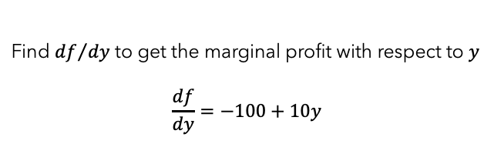
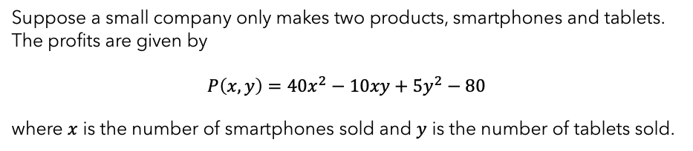
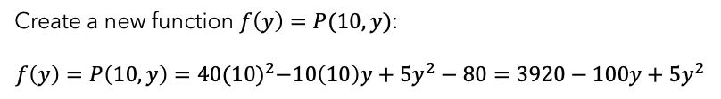
partial derivatives
Suppose a small company only makes two products, smartphones and tablets. The profits are given by
$$P\left(x,y\right)=40x^{2}−10xy+5y^{2}−80$$
where $x$ is the number of smartphones sold and $y$ is the number of tablets sold.
How will a change in $x$ or $y$ affect $P$?
Suppose that sales of smartphones have been steady at $10$ units and only the sales of tablets vary. How would we determine marginal profit with respect to $y$?
Create a new function $f\left(y\right)=P(10,y)$:
$$f\left(y\right)=P\left(10,y\right)=40{(10)}^{2}−10\left(10\right)y+5y^{2}−80=3920−100y+5y^{2}$$
This shows the profit from the sale of $y$ tablets, assuming $x$ is fixed at $10$
Find ${df}/{dy}$ to get the marginal profit with respect to $y$
$$\frac{df}{dy}=−100+10y$$

Slide 10

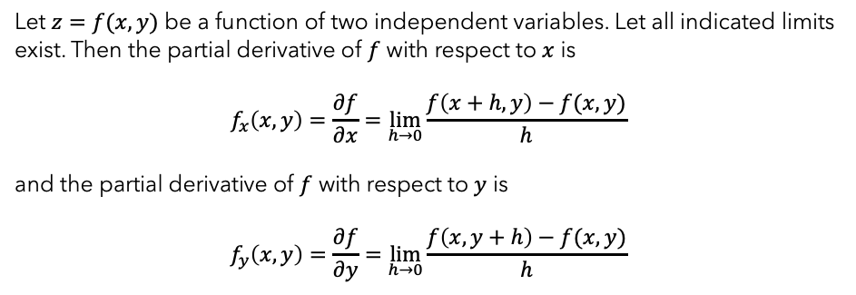

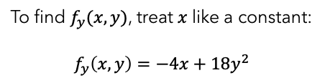
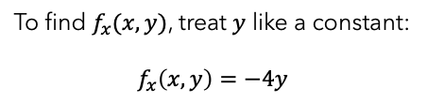
partial derivatives
Let $z=f(x,y)$ be a function of two independent variables. Let all indicated limits exist. Then the partial derivative of $f$ with respect to $x$ is
$$f_{x}\left(x,y\right)=\frac{∂f}{∂x}=\lim_{h→0}{\frac{f\left(x+h,y\right)−f(x,y)}{h}}$$
and the partial derivative of $f$ with respect to $y$ is
$$f_{y}\left(x,y\right)=\frac{∂f}{∂y}=\lim_{h→0}{\frac{f\left(x,y+h\right)−f(x,y)}{h}}$$
Let $f\left(x,y\right)=−4xy+6y^{3}+5$. Find $f_{x}(x,y)$ and $f_{y}(x,y)$
Using the formal definition of partial derivatives is not necessary
To find $f_{x}(x,y)$, treat $y$ like a constant:
$$f_{x}\left(x,y\right)=−4y$$
Your turn: Let $f\left(x,y\right)=2x^{2}y^{3}+6x^{5}y^{4}$. Find $f_{x}(x,y)$ and $f_{y}(x,y)$.
To find $f_{y}(x,y)$, treat $x$ like a constant:
$$f_{y}\left(x,y\right)=−4x+18y^{2}$$
Answer: $f_{x}\left(x,y\right)=4xy^{3}+30x^{4}y^{4}$ and $f_{y}\left(x,y\right)=6x^{2}y^{2}+24x^{5}y^{3}$
Notes:
Slides 10-12: Finding partial derivatives (#4 & #5)

Slide 11



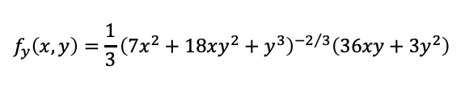
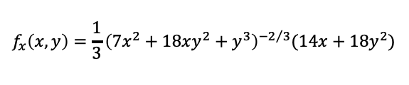
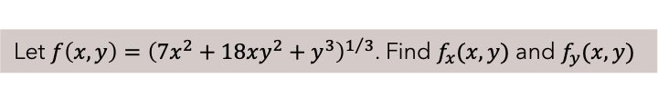
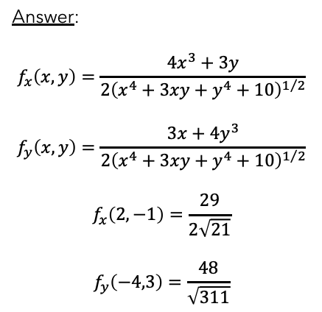
Examples
Let $f\left(x,y\right)=4e^{3x+2y}$. Find $f_{x}(x,y)$ and $f_{y}(x,y)$
$$f_{x}\left(x,y\right)=4e^{3x+2y}\left(3\right)=12e^{3x+2y}$$
Notice the chain rule applies here
Your turn: Let $f\left(x,y\right)=\sqrt{x^{4}+3xy+y^{4}+10}$. Find $f_{x}(x,y)$ and $f_{y}(x,y)$. Then find $f_{x}(2,−1)$ and $f_{y}(−4,3)$.
$$f_{y}\left(x,y\right)=8e^{3x+2y}$$
Answer:
$$f_{x}\left(x,y\right)=\frac{4x^{3}+3y}{2{\left(x^{4}+3xy+y^{4}+10\right)}^{1/2}}$$
$$f_{y}\left(x,y\right)=\frac{3x+4y^{3}}{2{\left(x^{4}+3xy+y^{4}+10\right)}^{1/2}}$$
$$f_{x}\left(2,−1\right)=\frac{29}{2\sqrt{21}}$$
$$f_{y}\left(−4,3\right)=\frac{48}{\sqrt{311}}$$
Let $f\left(x,y\right)={\left(7x^{2}+18xy^{2}+y^{3}\right)}^{1/3}$. Find $f_{x}(x,y)$ and $f_{y}(x,y)$
Apply the chain rule and the power rule
$$f_{x}\left(x,y\right)=\frac{1}{3}{\left(7x^{2}+18xy^{2}+y^{3}\right)}^{−2/3}(14x+18y^{2})$$
$$f_{y}\left(x,y\right)=\frac{1}{3}{\left(7x^{2}+18xy^{2}+y^{3}\right)}^{−2/3}\left(36xy+3y^{2}\right)$$

Slide 12
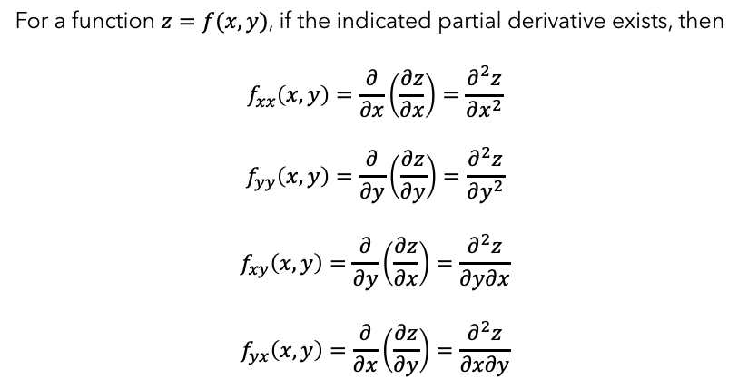
2nd order partial derivatives
For a function $z=f(x,y)$, if the indicated partial derivative exists, then
$$f_{xx}\left(x,y\right)=\frac{∂}{∂x}\left(\frac{∂z}{∂x}\right)=\frac{∂^{2}z}{∂x^{2}}$$
$$f_{yy}\left(x,y\right)=\frac{∂}{∂y}\left(\frac{∂z}{∂y}\right)=\frac{∂^{2}z}{∂y^{2}}$$
$$f_{xy}\left(x,y\right)=\frac{∂}{∂y}\left(\frac{∂z}{∂x}\right)=\frac{∂^{2}z}{∂y∂x}$$
$$f_{yx}\left(x,y\right)=\frac{∂}{∂x}\left(\frac{∂z}{∂y}\right)=\frac{∂^{2}z}{∂x∂y}$$
Clairaut’s Theorem: The mixed partials $f_{xy}$ and $f_{yx}$ are equal when $f$ is defined on an open disk $D$ containing the point $(a,b)$ and $f_{xy}$ and $f_{yx}$ are continuous on $D$.

Slide 13
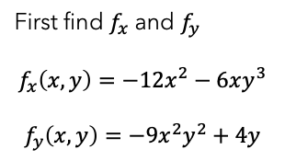




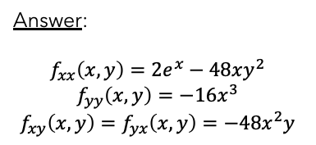
example
Find all second order partial derivatives for $f\left(x,y\right)=−4x^{3}−3x^{2}y^{3}+2y^{2}$
First find $f_{x}$ and $f_{y}$
$$f_{x}\left(x,y\right)=−12x^{2}−6xy^{3}$$
$$f_{y}\left(x,y\right)=−9x^{2}y^{2}+4y$$
$$f_{xy}\left(x,y\right)=\frac{∂^{2}f}{∂y∂x}=−18xy^{2}$$
$$f_{yx}\left(x,y\right)=\frac{∂^{2}f}{∂x∂y}=−18xy^{2}$$
$$f_{xx}\left(x,y\right)=\frac{∂^{2}f}{∂x^{2}}=−24x−6y^{3}$$
$$f_{yy}\left(x,y\right)=\frac{∂^{2}f}{∂y^{2}}=−18x^{2}y+4$$
Your turn: Let $f\left(x,y\right)=2e^{x}−8x^{3}y^{2}$. Find all second order partial derivatives.
Answer:
$$f_{xx}\left(x,y\right)=2e^{x}−48xy^{2}$$
$$f_{yy}\left(x,y\right)=−16x^{3}$$
$$f_{xy}\left(x,y\right)=f_{yx}\left(x,y\right)=−48x^{2}y$$

Slide 14
Module 7
maxima and minima

Slide 15
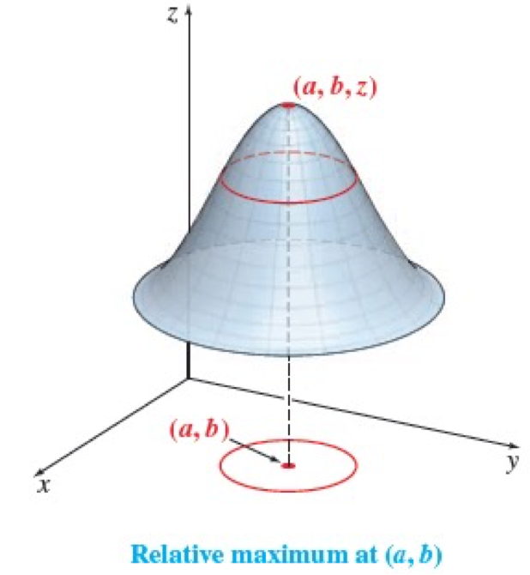
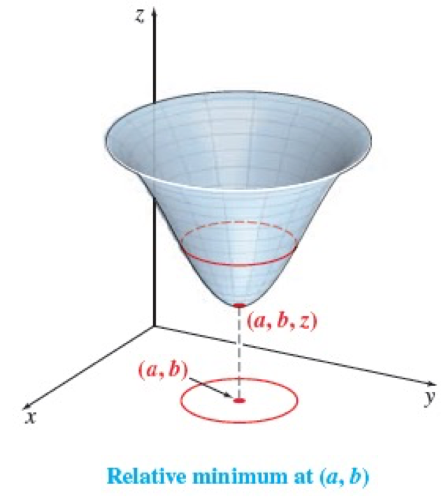
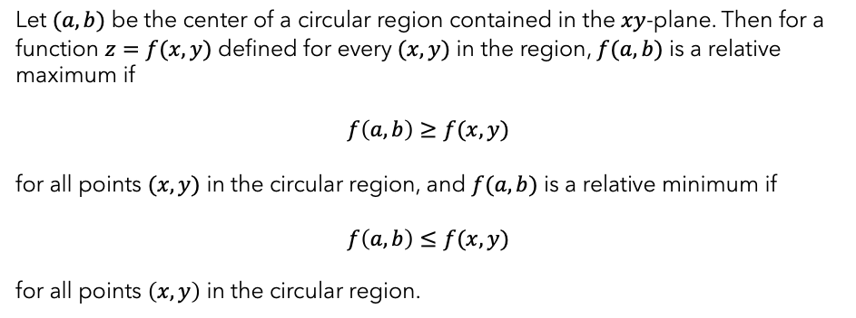
Relative maxima and minima
Let $(a,b)$ be the center of a circular region contained in the $xy$-plane. Then for a function $z=f(x,y)$ defined for every $(x,y)$ in the region, $f(a,b)$ is a relative maximum if
$$f\left(a,b\right)≥f(x,y)$$
for all points $(x,y)$ in the circular region, and $f(a,b)$ is a relative minimum if
$$f\left(a,b\right)≤f(x,y)$$
for all points $\left(x,y\right)$ in the circular region.

Slide 16
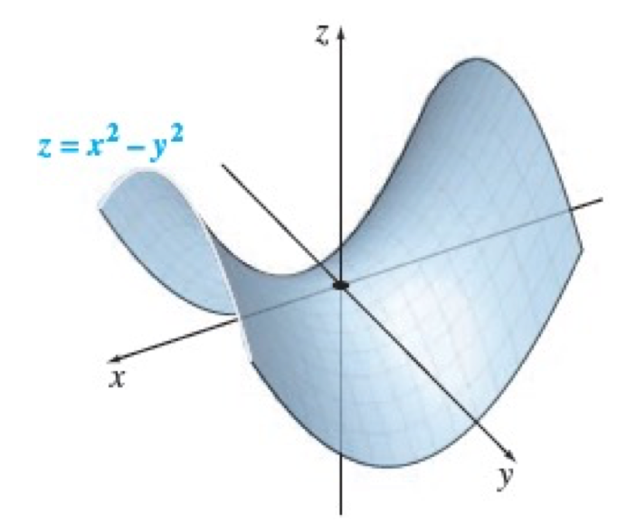
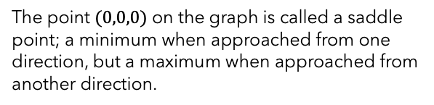


location of extrema
Let a function $z=f(x,y)$ have a relative maximum or relative minimum at the point $(a,b)$. Let $f_{x}(a,b)$ and $f_{y}(a,b)$ both exist. Then $f_{x}\left(a,b\right)=0$ and $f_{y}\left(a,b\right)=0$
If $f_{x}\left(a,b\right)=0$ and $f_{y}\left(a,b\right)=0$, this does not guarantee a relative minimum or relative maximum at $(a,b)$
Consider the graph of $z=f\left(x,y\right)=x^{2}−y^{2}$
$f_{x}\left(0,0\right)=0$ and $f_{y}\left(0,0\right)=0$ but $(0,0)$ is neither a relative maximum nor a relative minimum
The point $(0,0,0)$ on the graph is called a saddle point; a minimum when approached from one direction, but a maximum when approached from another direction.

Slide 17

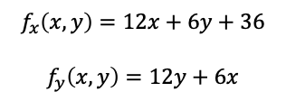

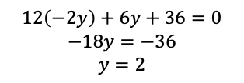

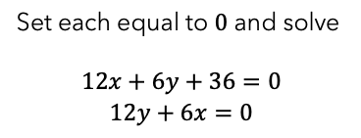
critical points
Find all critical points for $f\left(x,y\right)=6x^{2}+6y^{2}+6xy+36x−5$
$$f_{x}\left(x,y\right)=12x+6y+36$$
$$f_{y}\left(x,y\right)=12y+6x$$
$$12\left(−2y\right)+6y+36=0$$
$$−18y=−36$$
$$y=2$$
Set each equal to $0$ and solve
$$12x+6y+36=0$$
$$12y+6x=0$$
Since $y=2$, we have $x=−4$
$(−4,2)$ is the only critical point.
$12y+6x=0$ → $x=−2y$
This only guarantees that if $f$ has a relative extremum, it will occur at this point.

Slide 18
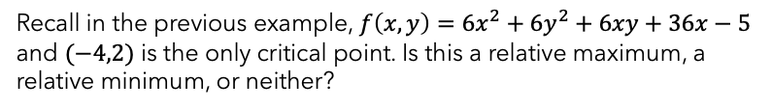
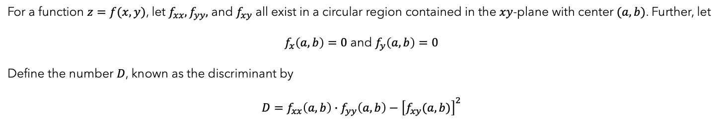




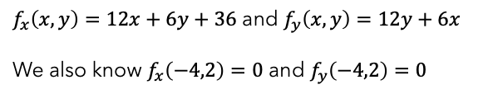
test for relative extrema
For a function $z=f(x,y)$, let $f_{xx}, f_{yy},$ and $f_{xy}$ all exist in a circular region contained in the $xy$-plane with center $(a,b)$. Further, let
$f_{x}\left(a,b\right)=0$ and $f_{y}\left(a,b\right)=0$
Define the number $D$, known as the discriminant by
$$D=f_{xx}\left(a,b\right)∙f_{yy}\left(a,b\right)−{\left[f_{xy}(a,b)\right]}^{2}$$
$f(a,b)$ is a relative maximum if $D>0$ and $f_{xx}\left(a,b\right)<0$
$f_{x}\left(x,y\right)=12x+6y+36$ and $f_{y}\left(x,y\right)=12y+6x$
We also know $f_{x}\left(−4,2\right)=0$ and $f_{y}\left(−4,2\right)=0$
$f(a,b)$ is a relative minimum if $D>0$ and $f_{xx}\left(a,b\right)>0$
$f(a,b)$ is a saddle point if $D<0$
If $D=0$, the test gives no information
$f_{xx}\left(x,y\right)=12$, $f_{yy}\left(x,y\right)=12$, and $f_{xy}\left(x,y\right)=6$
$$D=12\left(12\right)−6^{2}=108$$
Recall in the previous example, $f\left(x,y\right)=6x^{2}+6y^{2}+6xy+36x−5$ and $(−4,2)$ is the only critical point. Is this a relative maximum, a relative minimum, or neither?
$$f_{xx}\left(−4,2\right)=12$$
$f$ has a relative minimum at $(−4,2)$ and $f\left(−4,2\right)=−77$
Notes:
Slide 20: Remove f_xx(-4,2) =12

Slide 19


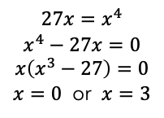

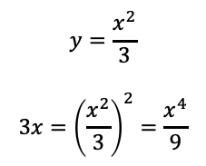

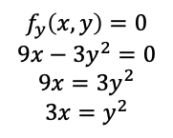
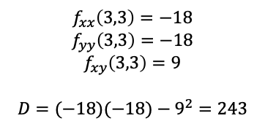
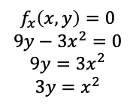
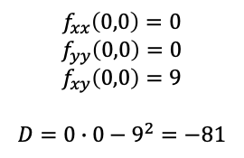
example
Find all points where the function $f\left(x,y\right)=9xy−x^{3}−y^{3}−6$ has any relative maxima or relative minima. Identify any saddle points.
$f_{x}\left(x,y\right)=9y−3x^{2}$ and $f_{y}\left(x,y\right)=9x−3y^{2}$
$f_{xx}\left(x,y\right)=−6x$, $f_{yy}\left(x,y\right)=−6y$, and $f_{xy}\left(x,y\right)=9$
$$f_{x}\left(x,y\right)=0$$
$$9y−3x^{2}=0$$
$$9y=3x^{2}$$
$$3y=x^{2}$$
$$f_{y}\left(x,y\right)=0$$
$$9x−3y^{2}=0$$
$$9x=3y^{2}$$
$$3x=y^{2}$$
$$f_{xx}\left(0,0\right)=0$$
$$f_{yy}\left(0,0\right)=0$$
$$f_{xy}\left(0,0\right)=9$$
$$D=0∙0−9^{2}=−81$$
$$f_{xx}\left(3,3\right)=−18$$
$$f_{yy}\left(3,3\right)=−18$$
$$f_{xy}\left(3,3\right)=9$$
$$D=(−18)(−18)−9^{2}=243$$
$$y=\frac{x^{2}}{3}$$
$$3x={\left(\frac{x^{2}}{3}\right)}^{2}=\frac{x^{4}}{9}$$
Since $D<0$, there is a saddle point at $(0,0)$
Since $D>0$ and $f_{xx}\left(3,3\right)<0$, there is a relative maximum at $(3,3)$
$$27x=x^{4}$$
$$x^{4}−27x=0$$
$$x\left(x^{3}−27\right)=0$$
$x=0$ or $x=3$
If $x=0$, then $y=0$ and if $x=3$, then $y=3$

Slide 20
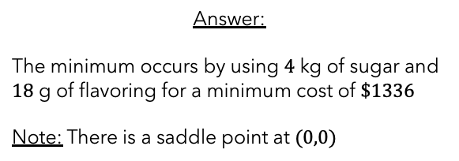
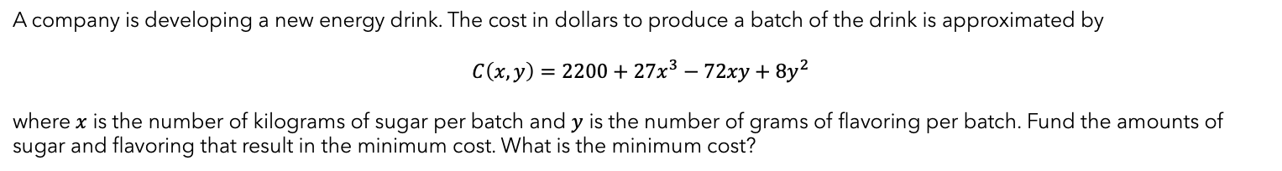
your turn
A company is developing a new energy drink. The cost in dollars to produce a batch of the drink is approximated by
$$C\left(x,y\right)=2200+27x^{3}−72xy+8y^{2}$$
where $x$ is the number of kilograms of sugar per batch and $y$ is the number of grams of flavoring per batch. Fund the amounts of sugar and flavoring that result in the minimum cost. What is the minimum cost?
Answer:
The minimum occurs by using $4$ kg of sugar and $18$ g of flavoring for a minimum cost of $\$1336$
Note: There is a saddle point at $(0,0)$

Slide 21
Module 7
lagrange multipliers

Slide 22
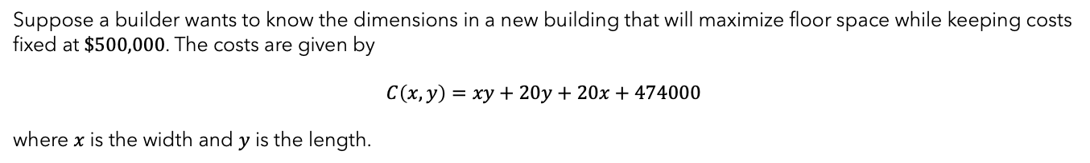
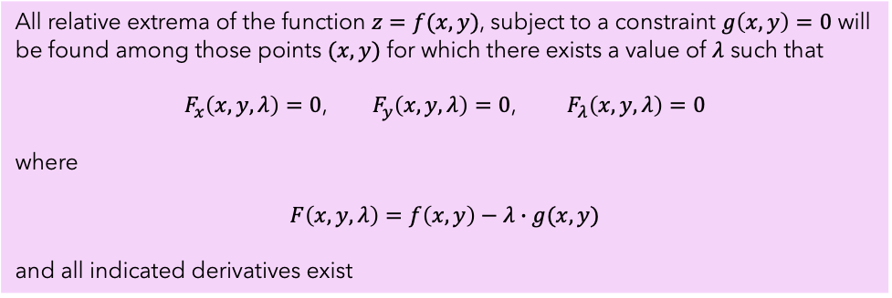
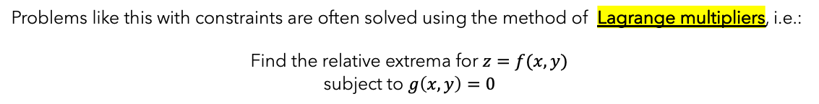
motivation & definition
Suppose a builder wants to know the dimensions in a new building that will maximize floor space while keeping costs fixed at $\$500,000$. The costs are given by
$$C\left(x,y\right)=xy+20y+20x+474000$$
where $x$ is the width and $y$ is the length.
So, the builder would like to maximize the area $A\left(x,y\right)=xy$ subject to $xy+20y+20x+474000=500000$
Problems like this with constraints are often solved using the method of Lagrange multipliers, i.e.:
Find the relative extrema for $z=f(x,y)$
subject to $g\left(x,y\right)=0$
All relative extrema of the function $z=f(x,y)$, subject to a constraint $g\left(x,y\right)=0$ will be found among those points $(x,y)$ for which there exists a value of $λ$ such that
$F_{x}\left(x,y,λ\right)=0$, $F_{y}\left(x,y,λ\right)=0$, $F_{λ}\left(x,y,λ\right)=0$
where
$$F\left(x,y,λ\right)=f\left(x,y\right)−λ∙g(x,y)$$
and all indicated derivatives exist

Slide 23
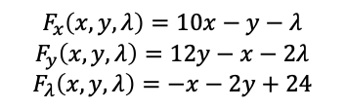
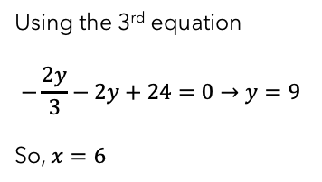


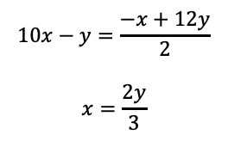




example
Find the minimum value of $f\left(x,y\right)=5x^{2}+6y^{2}−xy$ subject to the constraint $x+2y=24$
Step 1
Step 4
Rewrite the constraint in the form $g\left(x,y\right)=0$
Form the system of equations $F_{x}\left(x,y,λ\right)=0, F_{y}\left(x,y,λ\right)=0,$ and $F_{λ}\left(x,y,λ\right)=0$
$x+2y−24=0$, so $g\left(x,y\right)=x+2y−24$
$$10x−y−λ=0$$
$$12y−x−2λ=0$$
$$−x−2y+24=0$$
Step 2
Form the Lagrange function $F\left(x,y,λ\right)=f\left(x,y\right)−λ∙g(x,y)$
Step 5
$$F\left(x,y,λ\right)=5x^{2}+6y^{2}−xy−λ(x+2y−24)$$
$$=5x^{2}+6y^{2}−xy−λx−2λy+24λ$$
Solve the system from Step 4
$$10x−y−λ=0→λ=10x−y$$
$$12y−x−2λ=0→λ=\frac{−x+12y}{2}$$
Step 3
Find $F_{x}\left(x,y,λ\right), F_{y}\left(x,y,λ\right),$ and $F_{λ}(x,y,λ)$
Using the 3rd equation
$$−\frac{2y}{3}−2y+24=0→y=9$$
So, $x=6$
$$10x−y=\frac{−x+12y}{2}$$
$$x=\frac{2y}{3}$$
$$F_{x}\left(x,y,λ\right)=10x−y−λ$$
$$F_{y}\left(x,y,λ\right)=12y−x−2λ$$
$$F_{λ}\left(x,y,λ\right)=−x−2y+24$$
Your turn: Verify intermediate steps →

Slide 24

your turn
The 2nd derivative test for relative extrema demonstrated earlier does not apply to solutions found by Lagrange multipliers
1. Convince yourself that $f\left(6,9\right)=612$ is a minimum by trying a point very close to $(6,9)$. Your calculation should be larger than $612$.
2. Solve the example used in the motivation for Lagrange multipliers, i.e. Maximize the area, $A\left(x,y\right)=xy$ subject to the cost constraint
$$xy+20y+20x+474,000=500,000$$
then convince yourself the solution is a maximum using the method above.
You should get $x≈142.45$ and $y≈142.5$ for a maximum area of $≈20,306$ ft²

Slide 25
Module 7
tangent planes and differentials

Slide 26



tangent planes
Let $S$ be a surface defined by a differentiable function $z=f(x,y)$, and let $P=(x_{0},y_{0})$ be a point in the domain of $f$. Then the equation of the tangent plane to $S$ at $P$ is given by
$$z=f\left(x_{0},y_{0}\right)+f_{x}\left(x_{0},y_{0}\right)\left(x−x_{0}\right)+f_{y}(x_{0},y_{0})(y−y_{0})$$
Find the equation of the tangent plane to the surface defined by the function $f\left(x,y\right)=x^{3}−x^{2}y+y^{2}−2x+3y−2$ at the point $(−1,3)$
$$f_{x}\left(x,y\right)=3x^{2}−2xy−2$$
$$f_{y}\left(x,y\right)=−x^{2}+2y+3$$
$$f\left(−1,3\right)={\left(−1\right)}^{3}−{\left(−1\right)}^{2}\left(3\right)+3^{2}−2\left(−1\right)+3\left(3\right)−2=18$$
$$f_{x}\left(−1,3\right)=3{\left(−1\right)}^{2}−2\left(−1\right)(3)−2=7$$
$$f_{y}\left(−1,3\right)=−{\left(−1\right)}^{2}+2\left(3\right)+3=8$$
$$z=18+7\left(x−\left(−1\right)\right)+8(y−3)$$
$$=7x+8y−3$$

Slide 27




total differentials
Let $z=f(x,y)$ be a function of $x$ and $y$. Let $dx$ and $dy$ be real numbers. Then the total differential of $z$ is
$$dz=f_{x}\left(x,y\right)∙dx+f_{y}(x,y)∙dy$$
Consider the function $z=f\left(x,y\right)=9x^{3}−8x^{2}y+4y^{3}$.
(a) Find $dz$
(b) Evaluate $dz$ when $x=1, y=3, dx=0.01,$ and $dy=−0.02$
(a)
$f_{x}\left(x,y\right)=27x^{2}−16xy$ and $f_{y}\left(x,y\right)=−8x^{2}+12y^{2}$
By definition
$$dz=\left(27x^{2}−16xy\right)dx+\left(−8x^{2}+12y^{2}\right)dy$$
(b)
$$dz=\left[27\left(1^{2}\right)−16\left(1\right)\left(3\right)\right]\left(0.01\right)+\left[−8\left(1^{2}\right)+12\left(3^{2}\right)\right]\left(−0.02\right)=−2.21$$

Slide 28







approximations
Recall that with a function of one variable, $y=f(x)$, the differential $dy$ approximates the change in $y$ corresponding to a change in $x$. The change in $y$ is given by $∆y=f\left(x+dx\right)−f(x)$ and the change in $x$ is given by $∆x$.
The approximation of the differential $dz$ for a function of two variables and for small values of $dx$ and $dy$ is given by $dz≈∆z$, where $∆z=f\left(x+dx,y+dy\right)−f(x,y)$
Approximate $\sqrt{{2.98}^{2}+{4.01}^{2}}$
$$dz=\left(\frac{2x}{2\sqrt{x^{2}+y^{2}}}\right)dx+\left(\frac{2y}{2\sqrt{x^{2}+y^{2}}}\right)dy$$
$$=\left(\frac{x}{\sqrt{x^{2}+y^{2}}}\right)dx+\left(\frac{y}{\sqrt{x^{2}+y^{2}}}\right)dy$$
Notice that $2.98≈3$ and $4.01≈4$, and we know that $\sqrt{3^{2}+4^{2}}=5$
Let $f\left(x,y\right)=\sqrt{x^{2}+y^{2}}, x=3, dx=−0.02, y=4,$ and $dy=0.01$
Use $dz$ to approximate $∆z=\sqrt{{2.98}^{2}+{4.01}^{2}}−\sqrt{3^{2}+4^{2}}$
$$=\frac{3}{5}\left(−0.02\right)+\frac{4}{5}\left(0.01\right)=−0.004$$
$$dz=f_{x}\left(x,y\right)dx+f_{y}\left(x,y\right)dy$$
$$\sqrt{{2.98}^{2}+{4.01}^{2}}≈5+\left(−0.004\right)=4.996$$
Your turn: Approximate $\sqrt{{5.03}^{2}+{11.99}^{2}}$
Answer: $13.0023$

Slide 29







approximations by differentials
For a function $f$ having all indicated partial derivatives, and for small values of $dx$ and $dy$,
$$f\left(x+dx,y+dy\right)≈f\left(x,y\right)+dz$$
or
$$f\left(x+dx,y+dy\right)≈f\left(x,y\right)+f_{x}\left(x,y\right)dx+f_{y}\left(x,y\right)dy$$
The shape of a can of beer is a right circular cylinder where $r≈1.5$ in. and $h≈5$ in. How sensitive is the volume of the can to changes in the radius compared to changes in the height?
The volume of a right circular cylinder is given by $V=πr^{2}h$
To approximate the change in volume, find the total differential
$$dV=\left(2πrh\right)dr+\left(πr^{2}\right)dh$$
Your turn: A piece of bone in the shape of a right circular cylinder is $7$ cm long and has a radius of $1.4$ cm. It is coated with a layer of preservative $0.09$ cm thick. Use total differentials to estimate the volume of the preservative used.
Using $r=1.5$ and $h=5$, we have
$$dV=\left(2π\right)\left(1.5\right)\left(5\right)dr+π{\left(1.5\right)}^{2}dh=π\left(15dr+2.25dh\right)$$
The factor of $15$ in front of $dr$ compared with the factor of $2.25$ in front of $dh$ indicates that a small change in radius has almost $7$ times the effect on the volume as a small change in height.
Answer: $6.65$ cm³

Slide 30
Questions?

